Slide 1

Concept

Slide 2
CUSTOMER NAME
----
PROJECT
PART NAME
Guard_Assy.Side Sill_Splas
PART NO.
77230-58000
TYPE
Checking Fixture
DATE
19-12-2024

Slide 3
Part Images
A Surface
B Surface

Slide 4
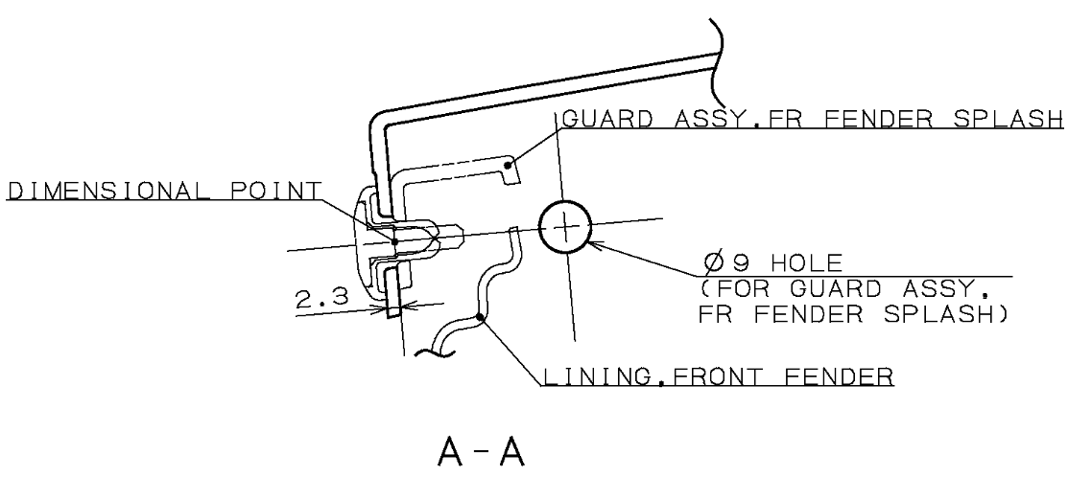
Resting & Locking
A
A
A-A
Part Hole Size:-Ø9mm
Pin Size:- Ø8.9mm
Part
Thread Pin
Stand
Bush(Resting)
Base Plate
Thread pin will be provided to rest and lock the part at 1 place as per drawing tolerance as shown above.

Slide 5
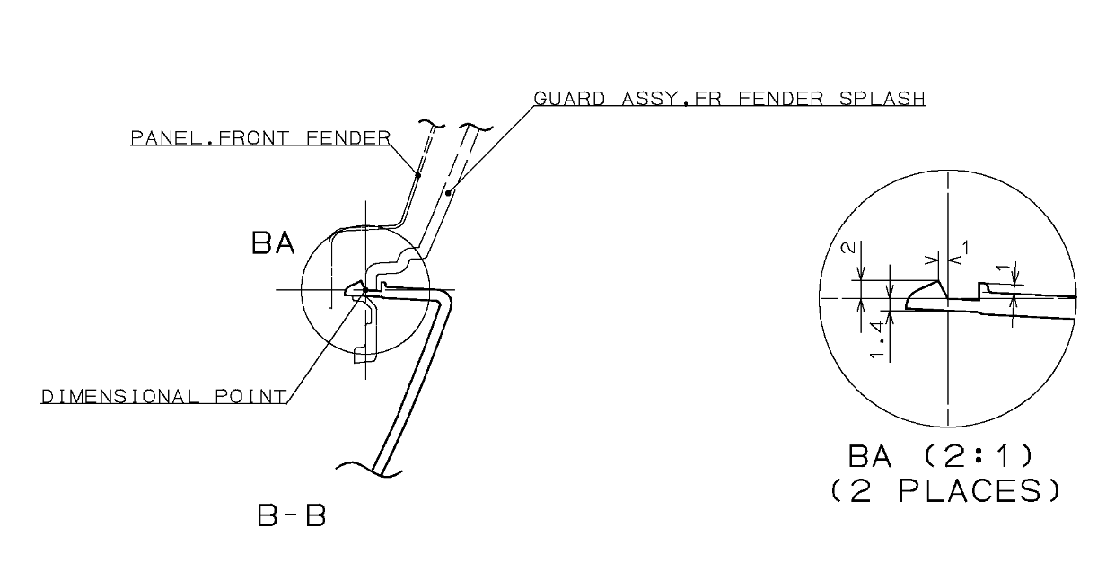
Locking
B
B-B
B
Stand
Mechanism
Base Plate
Part
One side locking mechanism will be provided as per surround to lock the part at 2 places as shown above.

Slide 6
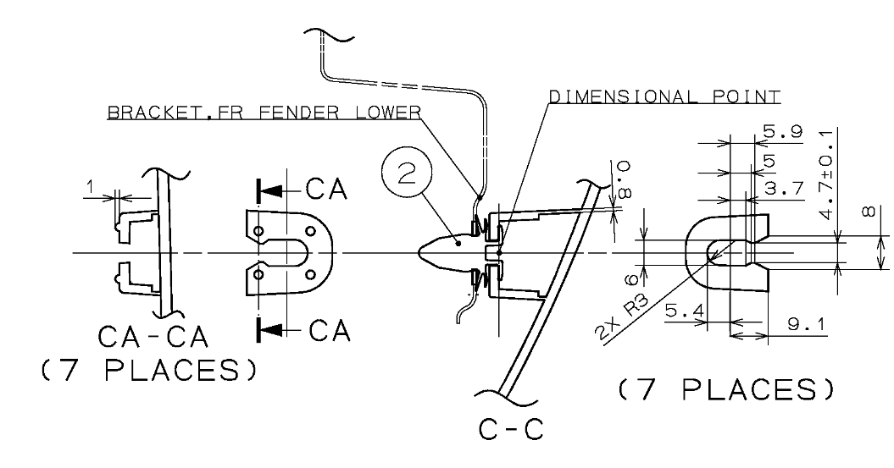
Resting & Locking
C
C-C
C
Mechanism
Part
Base Plate
Clutch operated mechanism will be provided as per surrounding to lock and rest the part at 07 places as shown above.

Slide 7
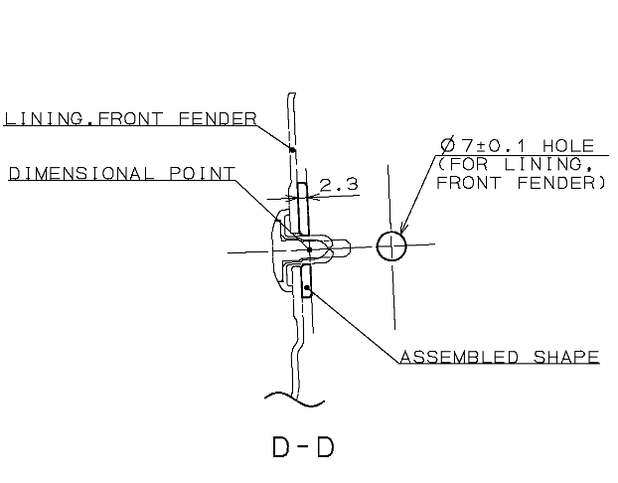
Resting & Locking
D-D
D
D
Part Hole Size:-Ø7mm
Pin Size:- Ø6.9mm
Part
Thread Pin
Stand
Bush(Resting)
Base Plate
The drawing and CAD model do not match; a hole shown in the drawing is missing in the CAD model
Thread pin will be provided to rest and lock the part at 1 place as per drawing tolerance as shown above.

Slide 8
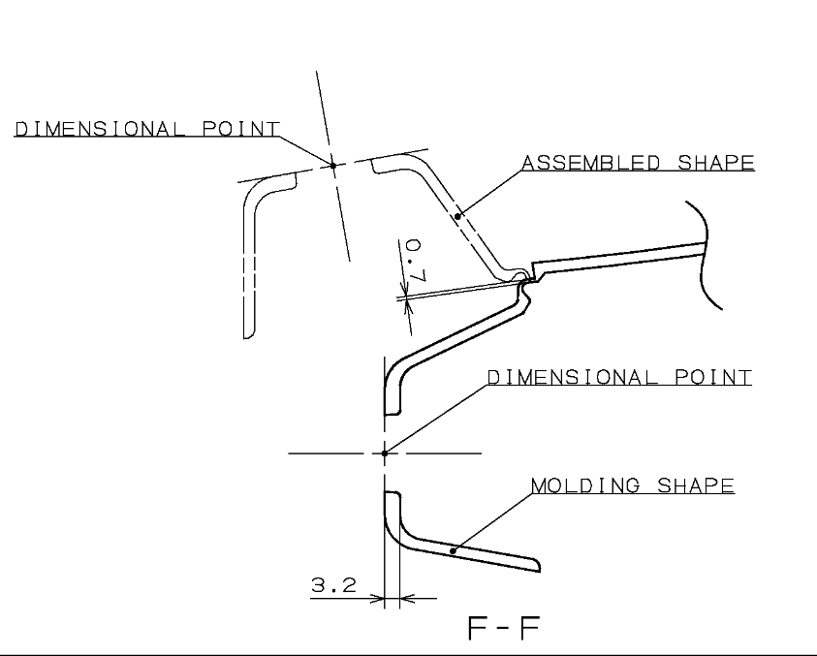
Resting & Locking
F-F
F
F
Part Hole Size:-Ø16mm
Pin Size:- Ø15.8mm
Part
Thread Pin
Stand
Bush(Resting)
Base Plate
Thread pin will be provided to rest and lock the part as per drawing tolerance as shown above.

Slide 9
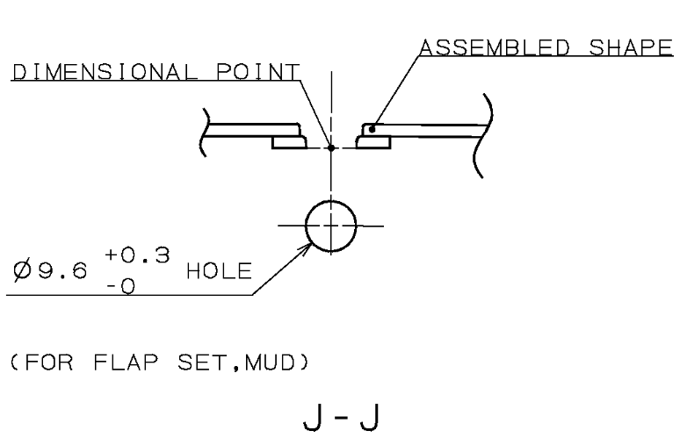
Resting & Locking
J-J
J
J
Part Hole Size:-Ø9.6mm
Pin Size:- Ø9.6mm
Stand
Part
Thread Pin
Base Plate
Thread pin will be provided to rest and lock the part as per drawing tolerance as shown above.

Slide 10
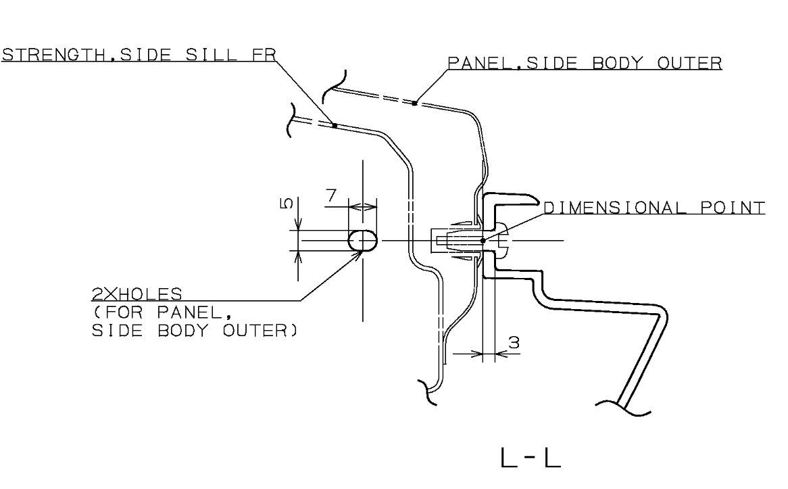
Resting & Locking
L
L-L
L
Part Hole Size:-5x7
Pin Size:- Ø4.9mm
Stand
Thread Pin
Part
Base Plate
Thread pin will be provided to rest and lock the part as per drawing tolerance as shown above.

Slide 11
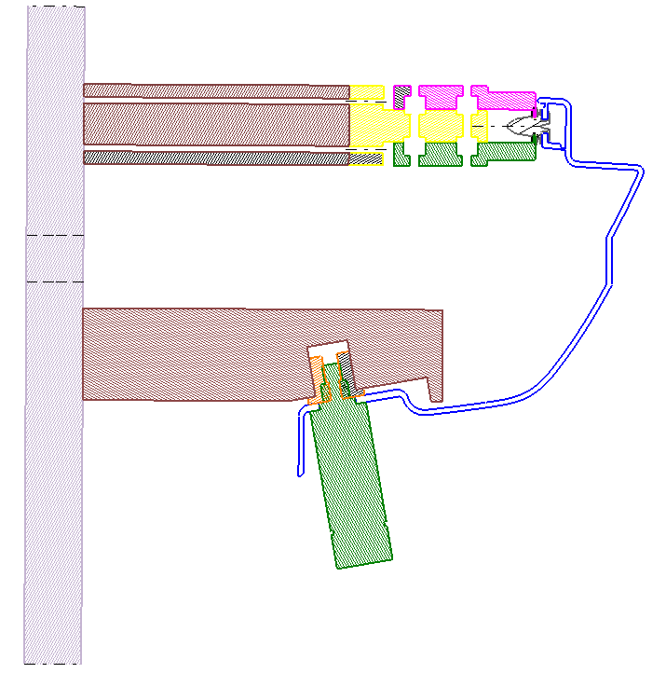
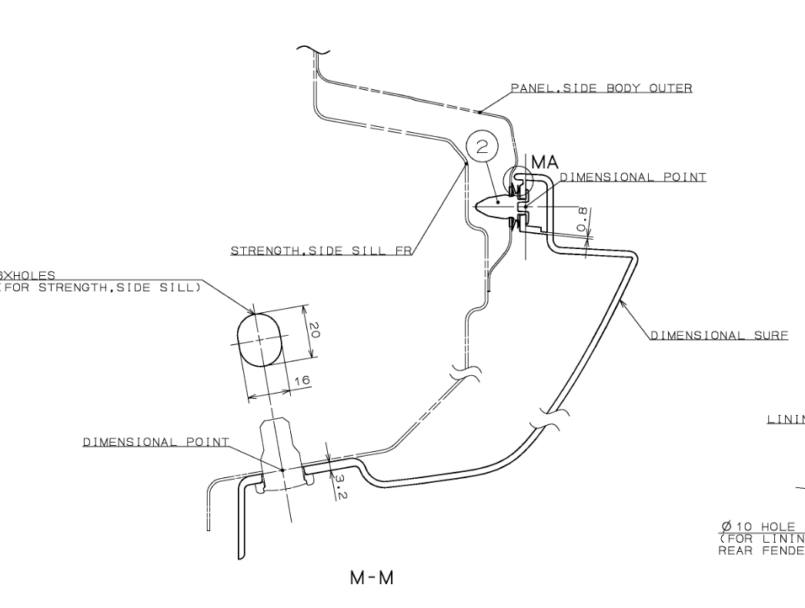
Resting & Locking
M
M-M
M
Mechanism
Stand
Part
Thread Pin
Base Plate
Mechanism and thread pin will be provided as shown above

Slide 12
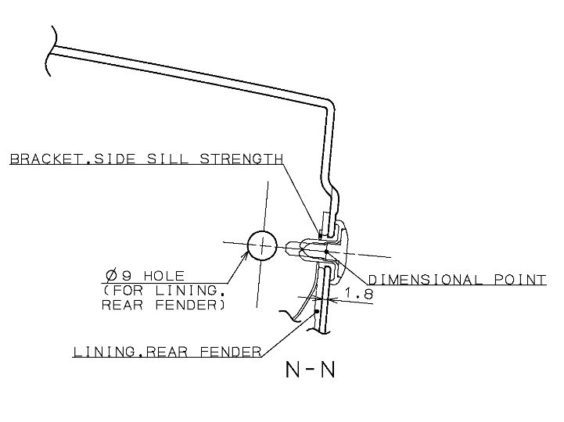
Resting & Locking
N
N
N-N
Part Hole Size:-Ø8mm
Pin Size:- Ø7.9mm
Part
Thread Pin
Stand
Base Plate
Thread pin will be provided to rest and lock the part at 1 place as per drawing tolerance as shown above.

Slide 13
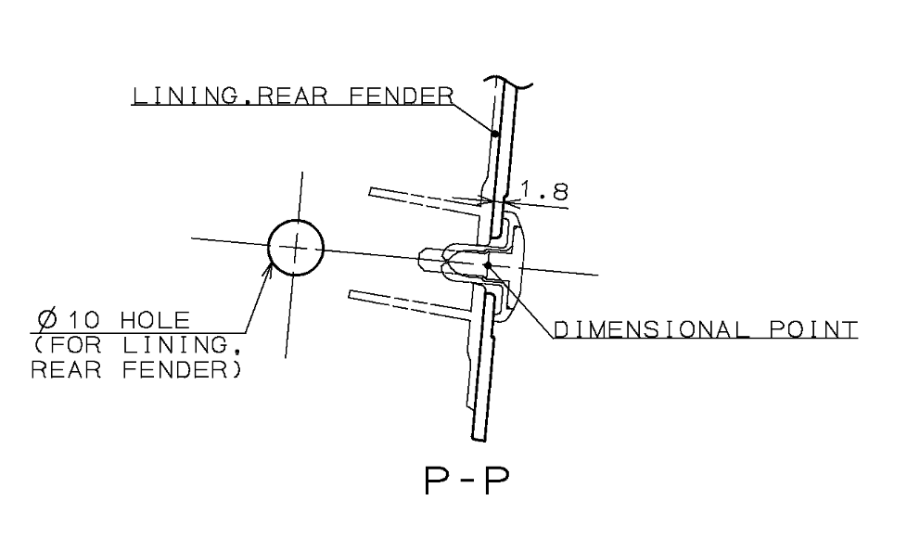
Resting & Locking
P-P
P
P
Part Hole Size:-Ø10mm
Pin Size:- Ø9.9mm
Part
Thread Pin
Stand
Base Plate
Thread pin will be provided to rest and lock the part at 1 place as per drawing tolerance as shown above.

Slide 14
Gap Flush
Q
Q-Q
Swing Template
Stand
Q
Base Plate
3
0
Body
Part
3
Swing template will be provided with 3mm gap and 0 mm flush and Body will be provided with 3mm gap and 0,3 mm trimline as shown above.

Slide 15
Gap Flush
S
S-S
R
R
S
Part
3
Part
3
Body
Body
Base Plate
Gap and Flush body will be provided all around the part with 3mm gap and 0 mm flush as shown in above image.
Base Plate
R-R

Slide 16
Fixture Orientation
Isometric
Top
Front
Side

Slide 17
Thank You

